Slide 1
Parallel Matrix-Matrix Multiplication
cs15btech11024, cs16btech11016

Slide 2
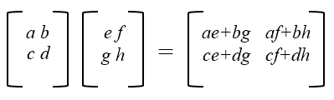
Background
O(n³) if elements of matrix C are computed sequentially - not optimal
Known optimal - O(n^{2.376}) - Coppersmith–Winograd algorithm
Can exploit the inherent parallelism to reduce the computation time.

Slide 3
Sequential
for (int i = 0; i < n; ++i)
for (int j = 0; j < n; ++j)
C[i][j] = 0;
for (int k = 0; k < n; ++k)
C[i][j] += A[i][k]*B[k][j];

Slide 4
Parallel algo1 - one thread one element
Each thread computes an element of result matrix C.
Pros
Extremely parallel
Theoretically takes constant time
Cons
O(n²) threads ⇒ not scalable
Huge thread overhead

Slide 5
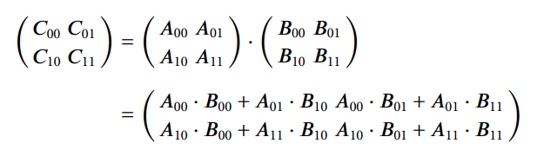
Parallel algo2 - Recursive Block
Decompose each matrix into 4 submatrices.
8 matrix multiplications can be computed parallely in a recursive manner.
4 additions can be computed parallely.

Slide 6
Contd.
Pros
Takes O(n²) time < sequential
Cons
Huge thread overhead - each thread recursively creates two other threads.
Difficult in C++ - thread pooling is not available.

Slide 7
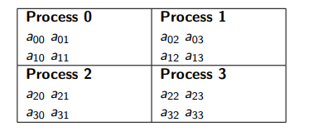
Checkerboard
Threads are viewed as a grid, rather than assigning entire rows or entire columns to each process, we assign small sub-matrices.

Slide 8
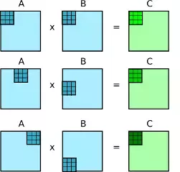
Parallel algo3 - Tiling
A row from tile of matrix A and a column from the tile of matrix B is assigned to one of the threads.
Threads calculate partial sums at the end of tile computation.
Number of threads ≤ tile length

Slide 9
Contd.
for(int jj=0; jj<z; jj= jj+tile_size)
for(int kk=0; kk<n; kk=kk+tile_size)
for(int i=jj; i< min(jj+tile_size,z); i++)
r = 0;
for(int k=kk; k<min(n,kk+tile_size); k++)
r += a[thread_id][k] * b[k][i];
c[thread_id][i] += r;

Slide 10
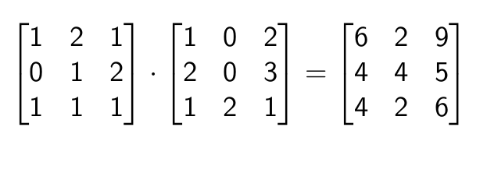
Parallel algo3 - SUMMA
Scalable Universal Matrix Multiplication Algorithm
Each thread takes a column from matrix A and a row from matrix B and computes a matrix of size n containing the partial sums.
Consider the following example

Slide 11
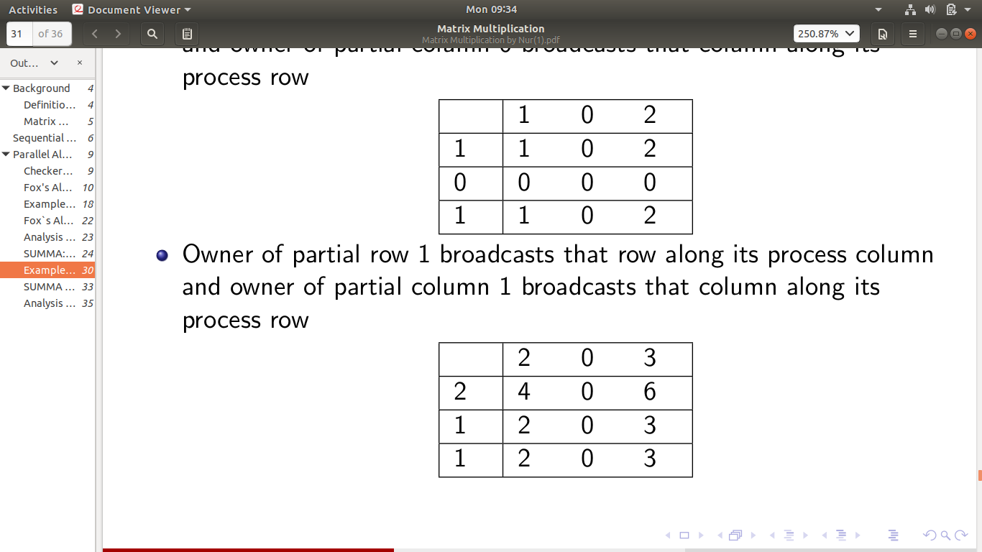
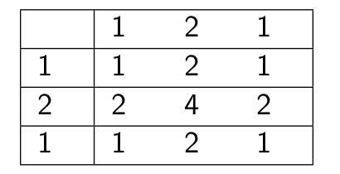
Contd.
Thread 1
Thread 2
Thread 3

Slide 12
Parallel algo3 - Work Stealing
Work Stealing is a simple work distribution approach in which a thread that runs out of work tries to “steal” work from the heavily loaded threads.
Assign work to each thread statically and let them do their work.
When a thread completes all of its assigned tasks, steals the work from a random thread whose work is not done yet.

Slide 13
Contd.
Every thread has a queue of tasks it has to complete.
Tasks are preassigned and pushed from bottom.
A thread pops from bottom from its own queue while completing the tasks.
A stealing thread - thread whose queue is empty - pop from top from the queue of thread from which it is stealing.
Every thread pop and then computes - threads may fail
Problem with compute and pop - atomic variables and CAS

Slide 14
Experiments

Slide 15
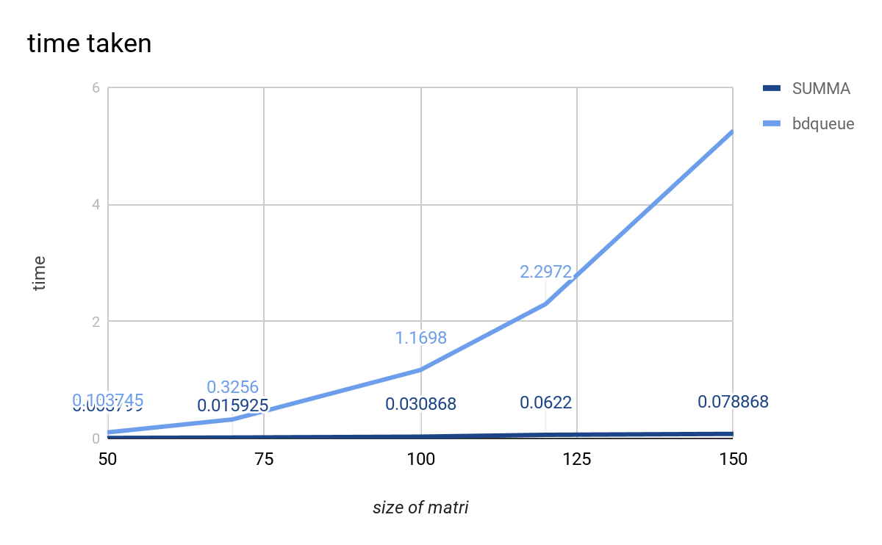
BDQ, SUMMA

Slide 16
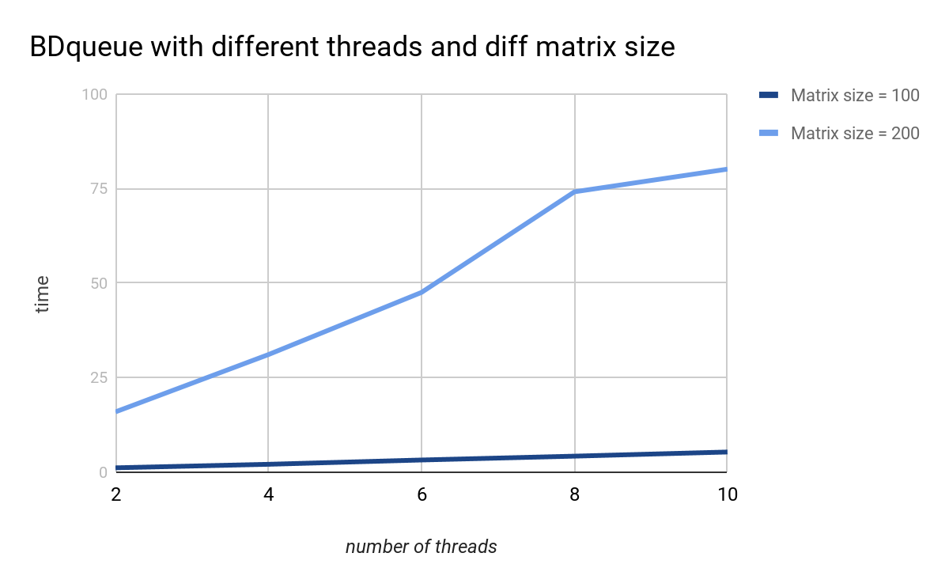

Slide 17
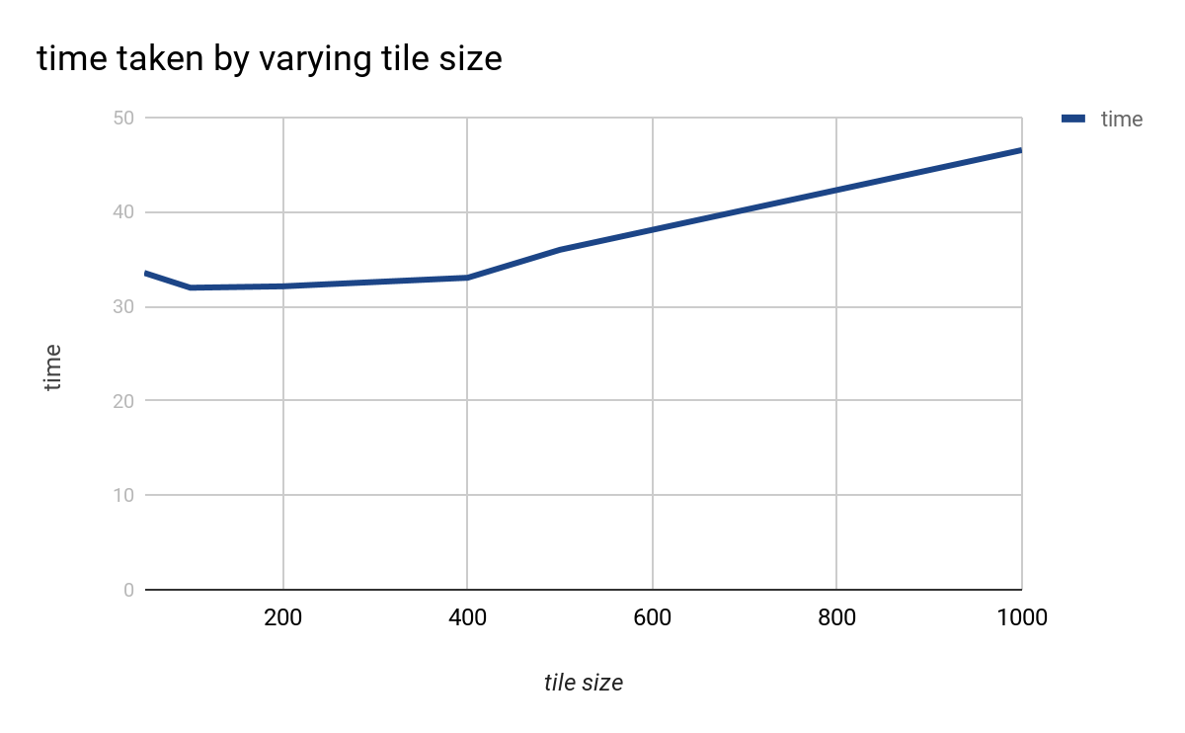
Tiling

Slide 18
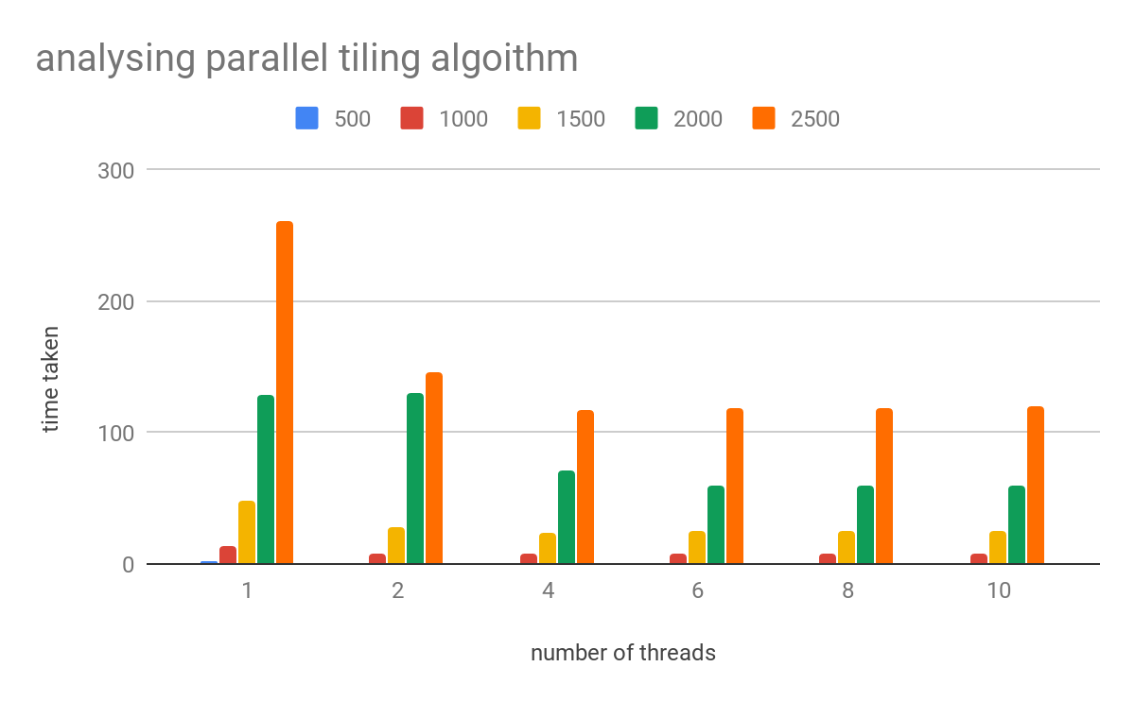
Tiling

Slide 19
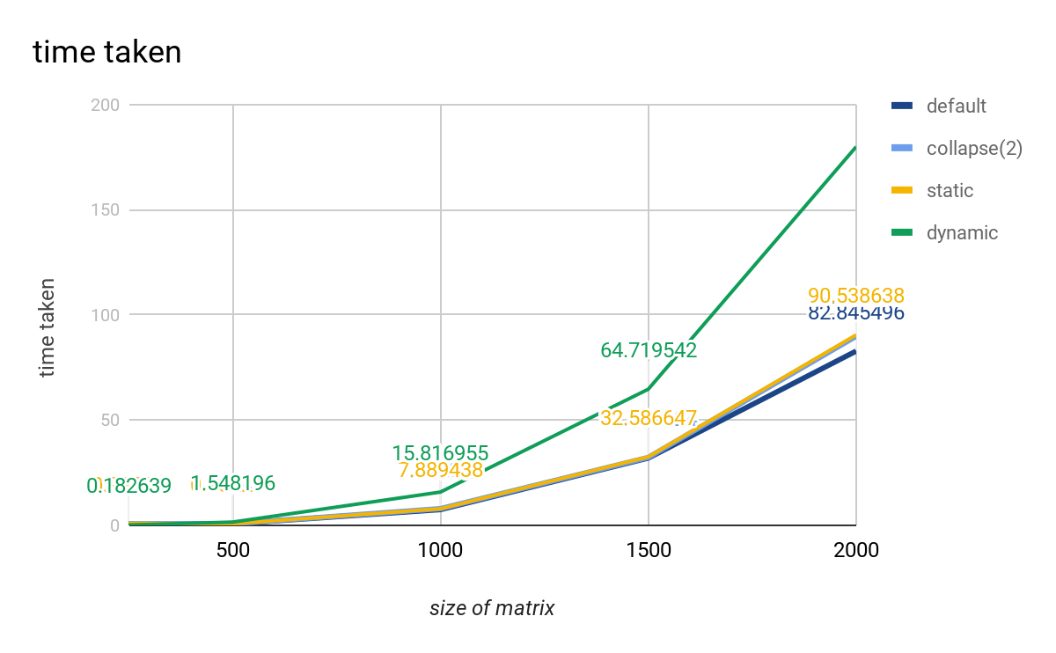
OMP
Time vs different constructs

Slide 20
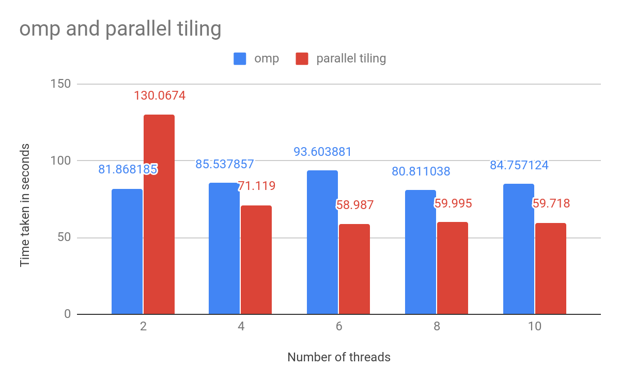
Comparison
Sequential, omp, one thread one element, tiling, bdq, summa
Time vs number of threads

Slide 21
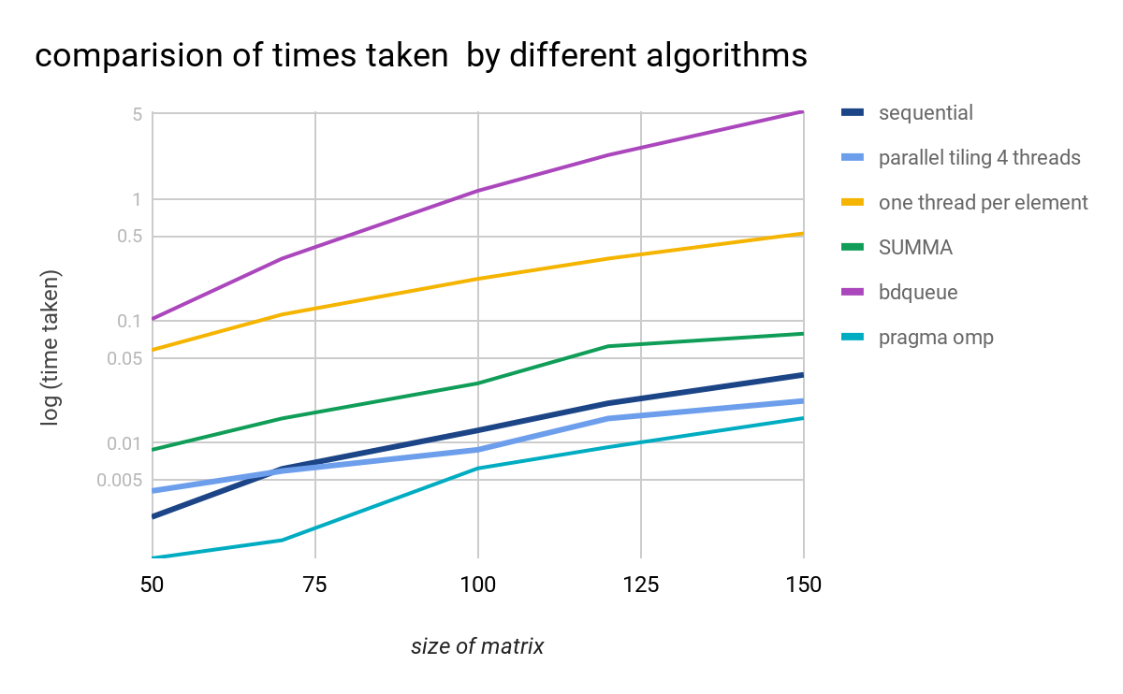

Slide 22
Thank You!

